Slide 1
How to prepare your Will, Living Will/Medical Directive, and Final Arrangements

Slide 2
Items to carefully consider
There are a few items you should consider when preparing the documents we are going to be talking about today. We encourage you to put some thought into each answer as you go through this process.
Who will you entrust to carry out any final wishes?
Do you have a safe place to keep your documents?
Do you have someone that will know where to find your documents?
Do you have a beneficiary that is over 18 years of age?
If not, do you have a Trust set up for any beneficiary under age 18?
If you do not have a beneficiary over age 18, any assets you have could sit in probate court. We would advise you to seek guidance from an attorney for more details.
We are not providing you with any legal guidance. The purpose of this information is to assist you in making your final arrangements. These documents may not provide you with all that is necessary if you have multiple properties and investments. We advise you to seek legal counsel.

Slide 3
What resources are available to me?
We will be reviewing the following:
Last Will and Testament
Living Will/Medical Directive
Final Arrangements
The Last Will and Testament is a free document.
The Living Will/Medical Directive is available for $14.99.
The Final Arrangements document is available for $9.99.
You can choose all, or any of the 3 that you would like to complete. Each completed document will need to be witnessed by 3 people (with a signature), and notarized.

Slide 4
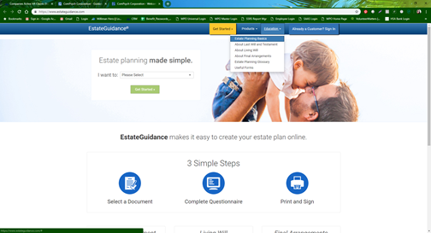
Additional Resources
If you need additional information, there are additional materials and educational pieces available to guide you through this process and answer any questions at the following:

Slide 5
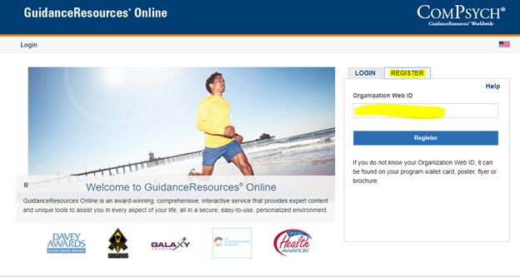
www.guidanceresources.com
Login to www.guidanceresources.com. Select Register and enter in code LifeKeys.

Slide 6
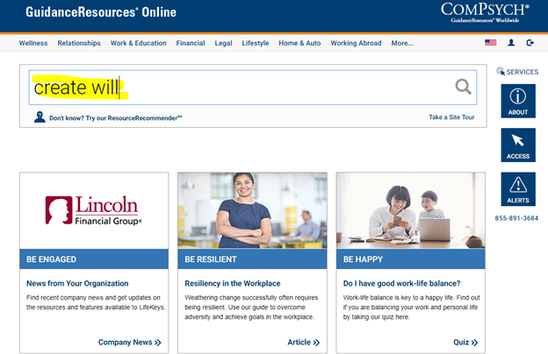
Create
In the search bar type in "create will".

Slide 7
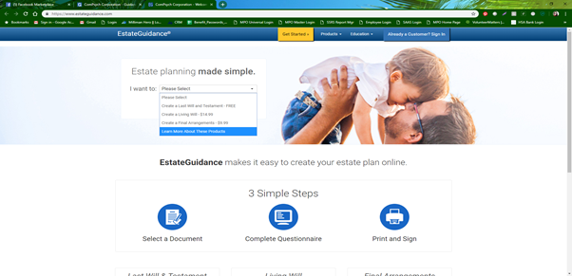
Select
You will get a Pop Up like this, select Continue.
From the Drop Down Select which document you would like to work on:

Slide 8
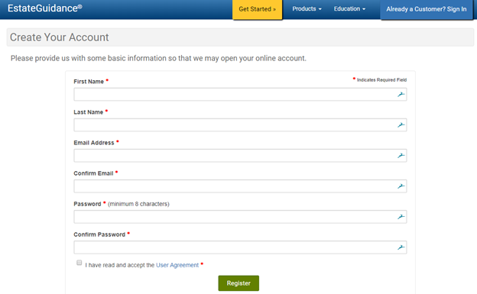
Register
Register your account. All of your documents will be saved here. You will also have the option to print your final documents and/or email them. You can also edit them when needed.

Slide 9
Complete
Your Last Will and Testament is free to create.
Your Living Will/Medical Directive is more detailed. The cost to create this document is $14.99.
Your Final Arrangements documents is also more detailed. The cost to create this is $9.99.
Once you complete each document, you will be able to save it and if you wish, email it.
For the Living Will/Medical Directive, and Final Arrangements, you will be asked to pay by debit or credit card to finalize those documents.
You will want to print each, get 3 witnesses to sign each, and then have all documents notarized to make them your official binding documents.

Slide 10
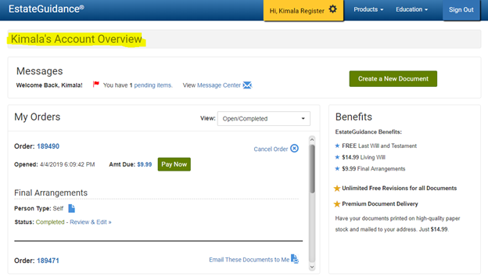
Review
Use the scroll bar to see all of the documents you have completed. You can review, edit, and email any of these documents as needed.

Slide 11
Final thoughts and questions
As a reminder, you will need to have each document witnessed and notarized. Make sure your loved ones know where your documents can be found in the event of your passing. We recommend a fire safe if possible.
We hope you found this information helpful. Should you have any questions, please contact Guidance Resources (EAP) for assistance at 1-855-891-3684.
Any questions?

